Slide 1
Creating Functions

Slide 2


Slide 3
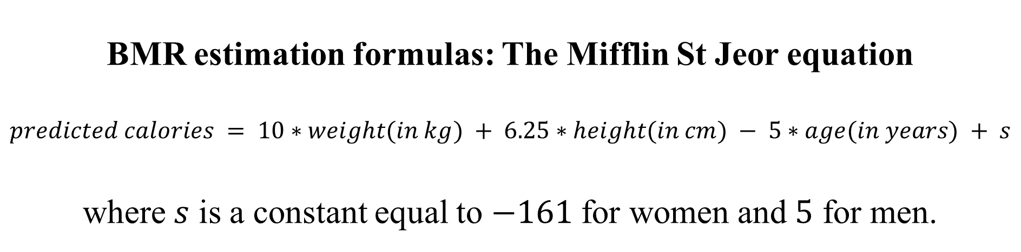
BMR estimation formulas: The Mifflin St Jeor equation
$$predicted calories = 10∗weight(in kg) + 6.25∗height(in cm) − 5∗age(in years) + s$$
where $s$ is a constant equal to $−161$ for women and $5$ for men.

Slide 4
Function Syntax
function_name<-function(argument1, argument2,...) {
Code to perform the task
return(result)
}

Slide 5
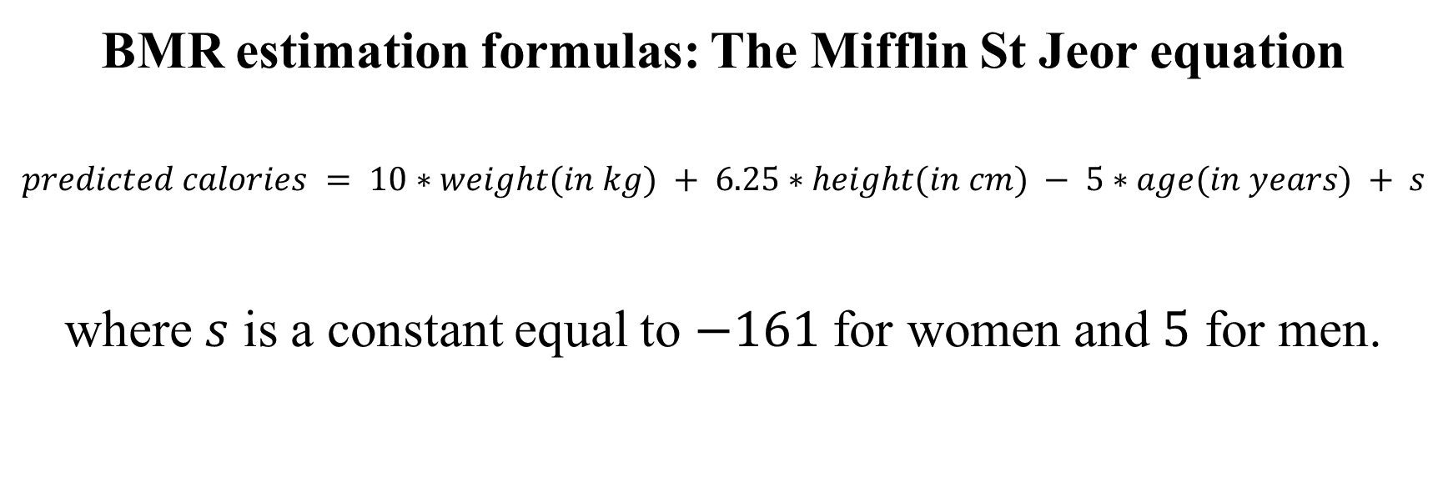
Example 1: Create a function that computes the predicted number of calories required by women.
BMR estimation formulas: The Mifflin St Jeor equation
$$predicted calories = 10∗weight(in kg) + 6.25∗height(in cm) − 5∗age(in years) + s$$
where $s$ is a constant equal to $−161$ for women and $5$ for men.

Slide 6
Codes:
calories_women <- function(weight, height, age){
calories <- (10 * weight) + (6.25 * height) - (5 * age) - 161
return(calories)
}
What is the output when I run this line after I ran the code that defines my function?
calories_women(weight = 65, height = 170, age = 35)
Output:

Slide 7
Using default values
calories_women_fixed <- function(weight, height, age = 30){
calories <- (10 * weight) + (6.25 * height) - (5 * age) - 161
return(calories)
}
calories_women_fixed(weight = 65, height = 170)
calories_women_fixed(weight = 65, height = 170, age = 35)

Slide 8
Example 2: Create a function for which the two arguments are two numbers a and b. Name this function “find_max”. Your function should print the maximum value between the two numbers or it should print that the two values are equal in the case that the two numbers are the same.
Code:

Slide 10
What would your function print if you ran these codes?
find_max(1,2) Output:
find_max(5,3) Output:
find_max(6,6) Output:

Slide 11
Example 3: Create a function that computes the mean of a vector. You have to build this function without the use of the default “mean” function provided by R. You should name this function mean_yourname. Hint: To sum the elements of a vector you can use sum and to calculate the number of elements in a vector, you can use length.
Codes:

Slide 13
What output would you get if you ran these lines:
v <- 1:4
mean_abdalla(v)
Output:

